Slide 1

World Wide Energy Consumption
Presented By : K. Sri Ram
Batch No : 436
Branch : Dilsukhnagar

Slide 2
About me:
I am Krishnasagarapu Sri Ram.
I have graduated with a B.Tech in Computer Science and Engineering (Data Science) from Vignana Bharathi Institute of Technology.
Linkedin : https://www.linkedin.com/in/sri-ram-krishnasagarapu-760a20239/
Github : https://github.com/Sriram943-collab

Slide 3
Agenda
Problem Statement
Objective
ER Diagram and schema explanation
SQL query results with screenshots
Final business insights and recommendations
Conclusion
Q&A Slide

Slide 4
Business Problem Statement :
Rapid economic growth and increasing energy demand have created challenges in managing emissions and ensuring sustainable energy use. To address this, governments, policymakers, and energy stakeholders - such as NTPC (National Thermal Power Corporation) and international organizations like the International Energy Agency (IEA)-require data-driven insights to balance economic growth with sustainable energy usage and emission control. This project analyzes global energy consumption, production, emissions, GDP, and population data using SQL to support informed decision-making and global comparisons for sustainable energy planning.

Slide 5
Objective :
To design and manage a structured SQL database for global energy, emissions, GDP, and population data.
To analyze country-wise energy production, consumption, and emission patterns over time.
To study the impact of population growth and economic factors (GDP) on energy usage and emissions.
To perform per-capita and ratio-based analysis for fair comparison across countries.
To generate meaningful insights that support sustainability evaluation and energy policy decision-making.

Slide 6
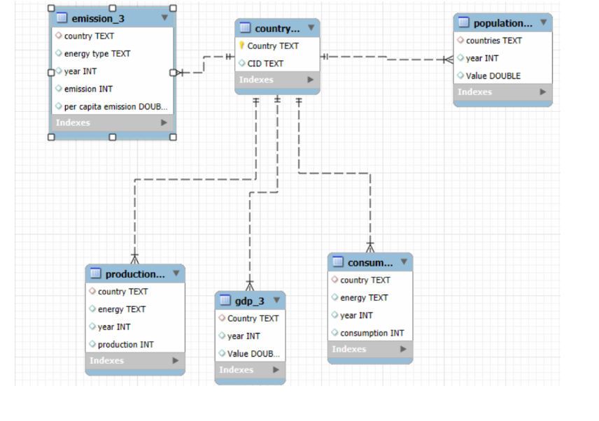
ER Diagram

Slide 7
Schema Overview:
ENERGYDB2 is a relational database designed to store and analyze global energy and economic data. It consists of six interconnected tables.
Tables Description:
Country : Master table containing unique country identifiers used as a reference across all datasets.
Emission_3 : Stores emissions data by country, year, and energy type, including per-capita emissions.
Population : Contains yearly population data for each country.
GDP_3 : Stores annual GDP values used for economic comparison.
Production : Records energy production by country, year, and energy source.
Consumption : Captures energy consumption patterns by country, year, and energy type.
Schema Relationships:
The Country table acts as the central master table.
The country column in all other tables is defined as a foreign key referencing the Country table.

Slide 8
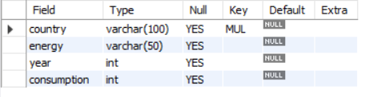

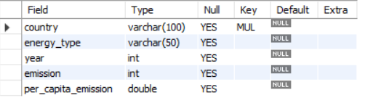
Table Structure:
Country Table
Consumption Table
Emission Table

Slide 9
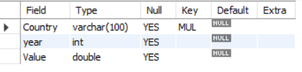
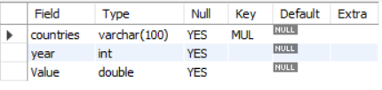
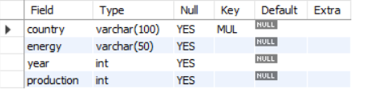
GDP Table
Population Table
Production Table

Slide 10
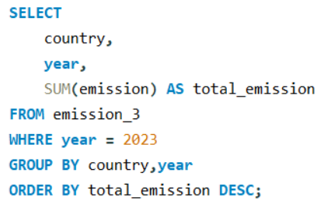
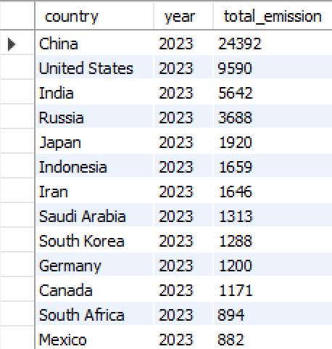

SQL Analysis and Query Results
What is the total emission per country for the most recent year available?
Query
Output

Slide 11
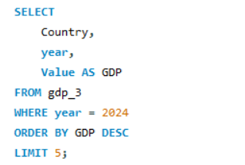
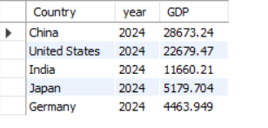
SQL Analysis and Query Results
What are the top 5 countries by GDP in the most recent year?
Query
Output

Slide 12
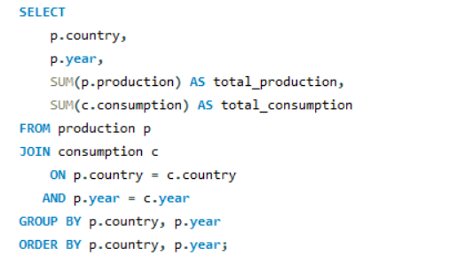
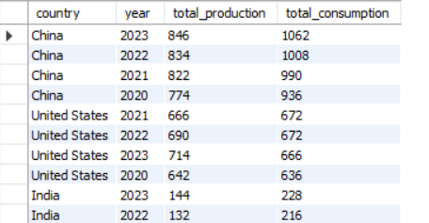
SQL Analysis and Query Results
Compare energy production and consumption by country and year?
Query
Output

Slide 13
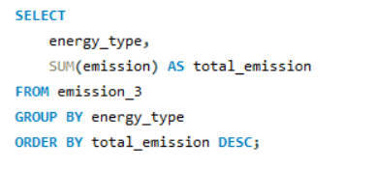
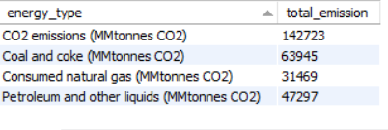
SQL Analysis and Query Results
Which energy types contribute most to emissions across all countries?
Query
Output

Slide 14
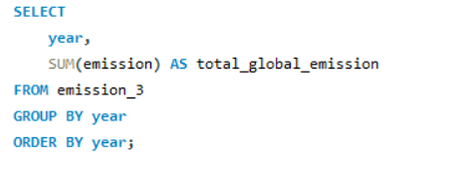
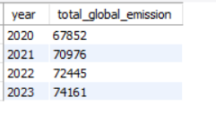
SQL Analysis and Query Results
How have global emissions changed year over year?
Query
Output

Slide 15
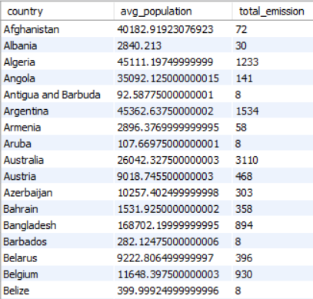
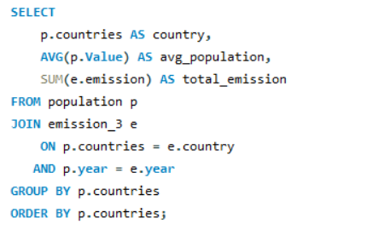
SQL Analysis and Query Results
How has population growth affected total emissions in each country?
Query
Output

Slide 16
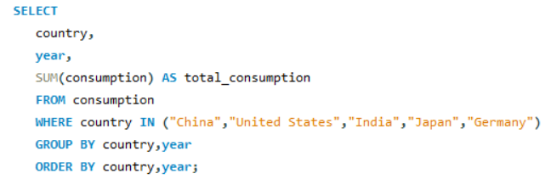
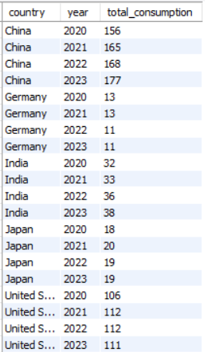
SQL Analysis and Query Results
Has energy consumption increased or decreased over the years for major economies?
Query
Output

Slide 17
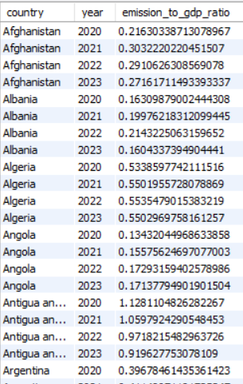
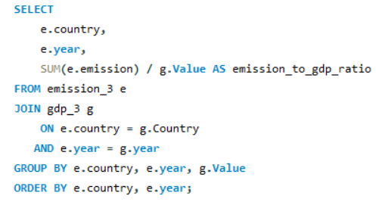
SQL Analysis and Query Results
What is the emission-to-GDP ratio for each country by year?
Query
Output

Slide 18
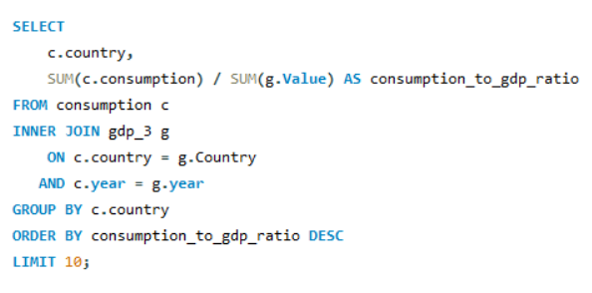
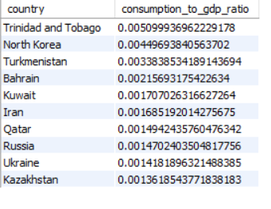
SQL Analysis and Query Results
Which countries have the highest energy consumption relative to GDP?
Query
Output

Slide 19
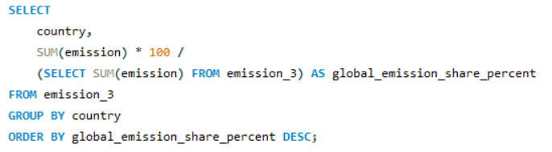
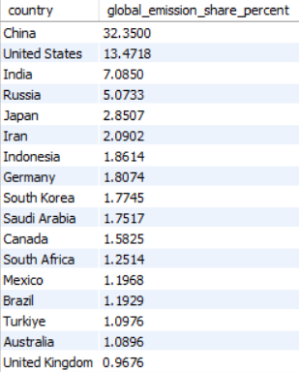
SQL Analysis and Query Results
What is the global share (%) of emissions by country?
Query
Output

Slide 20
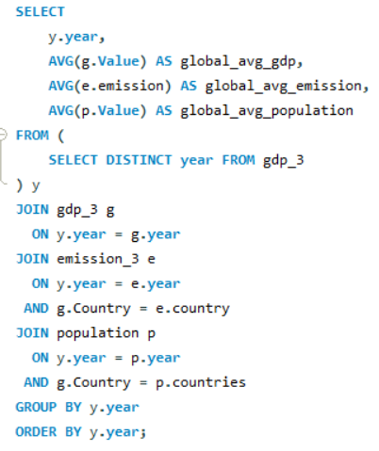
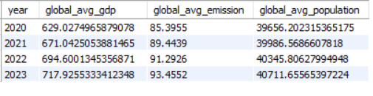
SQL Analysis and Query Results
What is the global average GDP, emission, and population by year?
Query
Output

Slide 21
Business Insights:
A small number of countries contribute most of the global carbon emissions.
Higher economic growth often leads to higher emissions, but efficiency differs by country.
Coal and coke are the largest contributors to carbon emissions among energy sources.
Global emissions have increased over time due to rising energy demand.
Some countries consume more energy than they produce, showing energy dependency.
Recommendations:
Prioritize emission reduction in high-emission, high-energy-use countries
Use per-capita and emission-to-GDP ratios for fair efficiency comparison
Align future energy planning with population and economic growth trends

Slide 22
Conclusion:
A relational SQL database was successfully designed and implemented to integrate global energy, emissions, GDP, and population data.
SQL queries were used to perform country-wise, year-wise, and per-capita analysis across multiple datasets.
The project demonstrates the effectiveness of SQL in converting complex global data into structured, meaningful analysis.
Overall, the study provides a strong data foundation to support sustainable energy planning and informed decision-making.

Slide 23
Q & A

Slide 24

THANK YOU

